Slide 1

DESIGN AND ANALYSIS OF ALGORITHMS
Dr. Kashif Ayyub

Slide 2
Time Complexity
There is always more than one way to solve a problem in computer science with different algorithms.
Therefore, it is highly required to use a method to compare the solutions in order to judge which one is more optimal. The method must be:
Independent of the machine and its configuration, on which the algorithm is running on.
Shows a direct correlation with the number of inputs.
Can distinguish two algorithms clearly without ambiguity.

Slide 3
Time Complexity
The time required by the algorithm to solve given problem is called time complexity of the algorithm.
The valid algorithm takes a finite amount of time for execution.
Time complexity is very useful measure in algorithm analysis.
It is the time needed for the completion of an algorithm.
To estimate the time complexity, we need to consider the cost of each fundamental instruction and the number of times the instruction is executed.
Note that the time to run is a function of the length of the input and not the actual execution time of the machine on which the algorithm is running on.

Slide 4

Time Complexity - Example
The addition of two integers
The addition of two scalar numbers requires one addition operation. the time complexity of this algorithm is constant, so T(n) = O(1).
In order to calculate time complexity of an algorithm, it is assumed that a constant time c is taken to execute one operation, and then the total operations for an input length on N are calculated.

Slide 5
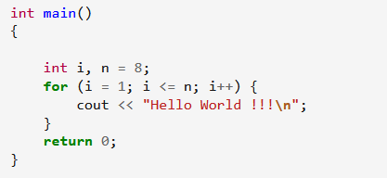
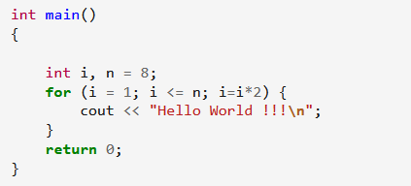
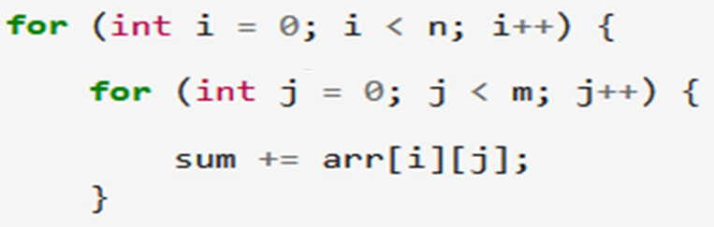



Time Complexity - Examples
$$O(n)$$
$$O(\log_{2}{n})$$
Add all elements of a matrix
$$O(n×m)$$

Slide 6
Algorithm Analysis - Example
Running Time:
The number of primitive
operations (steps) executed
before termination.
T(n) = 1 + (n-1) + (n-1) + (n-1)
= 3n – 2
Order (rate) of Growth:
The leading term of the formula
Expresses the asymptotic behavior of the algorithm
Min(a[1] … a[n])
m → a[1];
for c → 2 to n
if a[c] < m then
m → a[c];
1
n-1
n-1
n-1

Slide 7
Example
20 + 21 + … + (n-1) + n = ?

Slide 8



Example

Slide 9
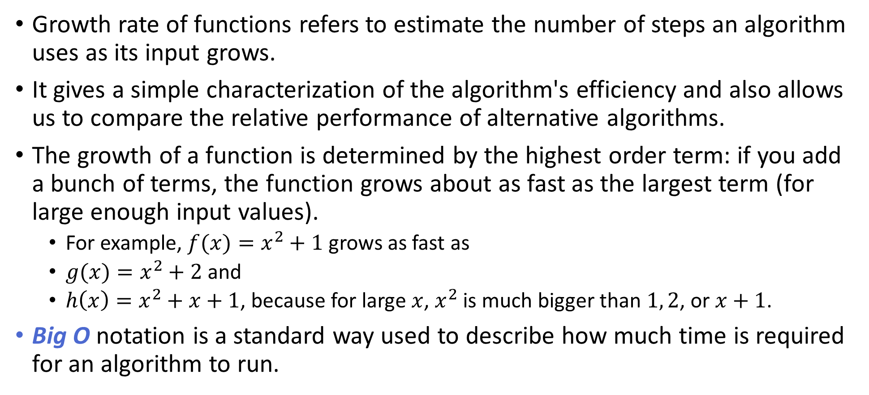
Growth Rate of Functions
Growth rate of functions refers to estimate the number of steps an algorithm uses as its input grows.
It gives a simple characterization of the algorithm's efficiency and also allows us to compare the relative performance of alternative algorithms.
The growth of a function is determined by the highest order term: if you add a bunch of terms, the function grows about as fast as the largest term (for large enough input values).
For example, $f(x)=x^{2}+1$ grows as fast as
$g(x)=x^{2}+2$ and
$h\left(x\right)=x^{2}+x+1$, because for large $x$, $x^{2}$ is much bigger than $1, 2$, or $x+1$.
Big O notation is a standard way used to describe how much time is required for an algorithm to run.

Slide 10
Typical Running Time Functions
1 (constant running time)
Instructions are executed once or a few times
logN (logarithmic)
A big problem is solved by cutting the original problem in smaller sizes, by a constant fraction at each step
N (linear)
A small amount of processing is done on each input element
N logN
A problem is solved by dividing it into smaller problems, solving them independently and combining the solution

Slide 11
Typical Running Time Functions
N² (quadratic)
Typical for algorithms that process all pairs of data items (double nested loops)
N³ (cubic)
Processing of triples of data (triple nested loops)
N^{K} (polynomial)
2^{N} (exponential)
Few exponential algorithms are appropriate for practical use

Slide 12
Some rules of thumb
Multiplicative constants can be omitted
14n² becomes n²
7 log n become log n
Lower order functions can be omitted
n + 5 becomes n
n² + n becomes n²
nª dominates n^{b} if a > b
n² dominates n, so n²+n becomes n²
n^{1.5} dominates n^{1.4}

Slide 13
Some rules of thumb
a^{n} dominates b^{n} if a > b
3^{n} dominates 2^{n}
Any exponential dominates any polynomial
3^{n} dominates n⁵
2^{n} dominates n^{c}
Any polynomial dominates any logorithm
n dominates log n or log log n
n² dominates n log n
n^{1/2} dominates log n
Do not omit lower order terms of different variables (n² + m) does not become n²

Slide 14
Some examples
O(1) – constant. Fixed amount of work, regardless of the input size
add two 32 bit numbers
determine if a number is even or odd
sum the first 20 elements of an array
delete an element from a doubly linked list
O(log n) – logarithmic. At each iteration, discards some portion of the input (i.e. half)
binary search

Slide 15
Some examples
O(n) – linear. Do a constant amount of work on each element of the input
find an item in a linked list
determine the largest element in an array
O(n log n) log-linear. Divide and conquer algorithms with a linear amount of work to recombine
Sort a list of number with Merge Sort
Heap Sort
Quick Sort

Slide 16
Some examples
O(n²) – quadratic. Double nested loops that iterate over the data
Bubble sort
O(2^{n}) – exponential
Enumerate all possible subsets
Traveling salesman using dynamic programming
O(n!)
Enumerate all permutations
determinant of a matrix with expansion by minors

Slide 17
Growth Rate of Functions
Input | logN | NlogN | N^2 | N^3 | 2^N
1 | 0.00 | 0.00 | 1 | 1 | 2
2 | 1.00 | 2.00 | 4 | 8 | 4
3 | 1.58 | 4.75 | 9 | 27 | 8
4 | 2.00 | 8.00 | 16 | 64 | 16
5 | 2.32 | 11.61 | 25 | 125 | 32
6 | 2.58 | 15.51 | 36 | 216 | 64
7 | 2.81 | 19.65 | 49 | 343 | 128
8 | 3.00 | 24.00 | 64 | 512 | 256
9 | 3.17 | 28.53 | 81 | 729 | 512
10 | 3.32 | 33.22 | 100 | 1000 | 1024
11 | 3.46 | 38.05 | 121 | 1331 | 2048
12 | 3.58 | 43.02 | 144 | 1728 | 4096
13 | 3.70 | 48.11 | 169 | 2197 | 8192
14 | 3.81 | 53.30 | 196 | 2744 | 16384
15 | 3.91 | 58.60 | 225 | 3375 | 32768
16 | 4.00 | 64.00 | 256 | 4096 | 65536
17 | 4.09 | 69.49 | 289 | 4913 | 131072
18 | 4.17 | 75.06 | 324 | 5832 | 262144
19 | 4.25 | 80.71 | 361 | 6859 | 524288
20 | 4.32 | 86.44 | 400 | 8000 | 1048576

Slide 18
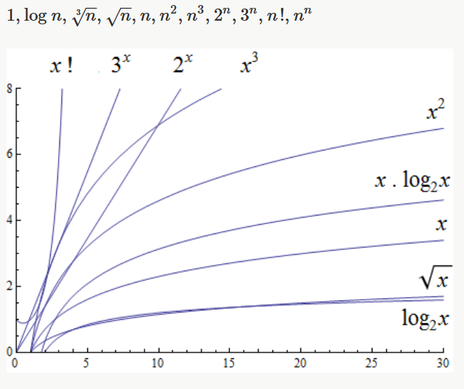
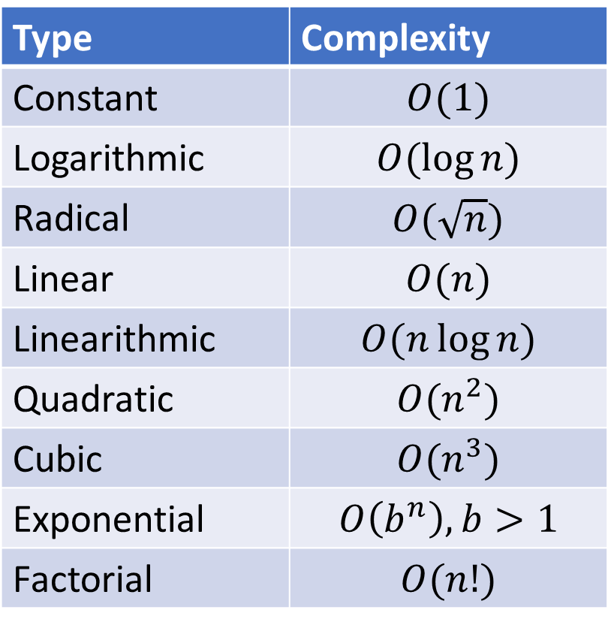
Growth Rate of Functions
The size of the input complexities ordered from smallest to largest:
Type | Complexity
Constant | $$O(1)$$
Logarithmic | $$O(\log{n})$$
Radical | $$O(\sqrt{n})$$
Linear | $$O(n)$$
Linearithmic | $$O(n\log{n})$$
Quadratic | $$O(n^{2})$$
Cubic | $$O(n^{3})$$
Exponential | $$O\left(b^{n}\right), b>1$$
Factorial | $$O(n!)$$
Ordering of Basic Functions by Growth

